Slide 1
Chapter 1 Issues Addressed

Slide 2
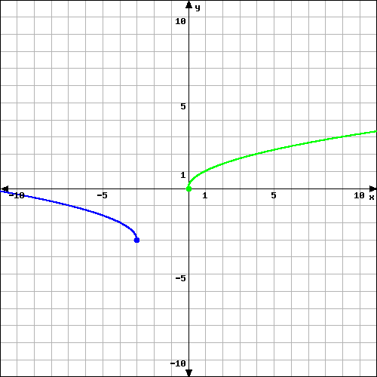
Chapter 1.3
If you are graphing transformations involving reflections, to follow the same process we have used in class, you must:
Apply horizontal and vertical shifts first to get you to the location you want to mirror.
Then apply the reflection. (e.g., apply f(-x) in this case.
Then apply the vertical shift so that you end up at your desired location.
General guidelines for Order:
Horizontal Shift
Reflections
Vertical Shift

Slide 3
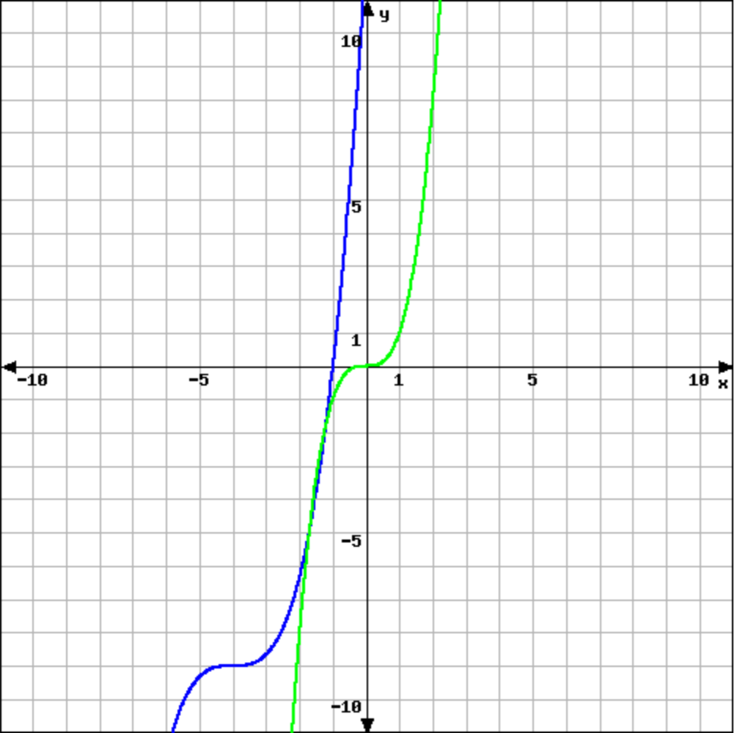
Determining Equation from the Graph

Slide 4
HW 1.1, #6
Given the function f(x) = – 3x² – 2x + 4, find…
f(x – 2) – f(x)

Slide 5
This text shows up above the board.
This text shows up on the board.

Slide 6
This text shows up above the board.
This text shows up on the board.

